Slide 1
Getting Certified
Options, pitfalls, and more

Slide 2

Do I get certified and if so which one?

Slide 3
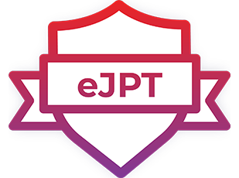
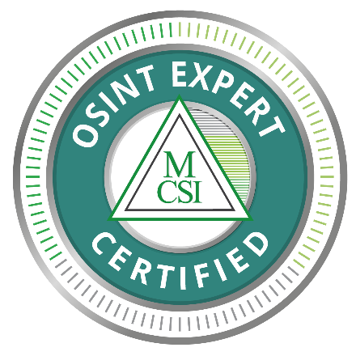
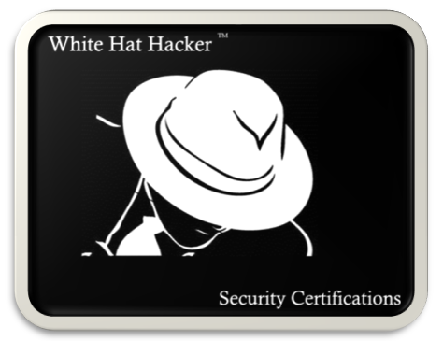
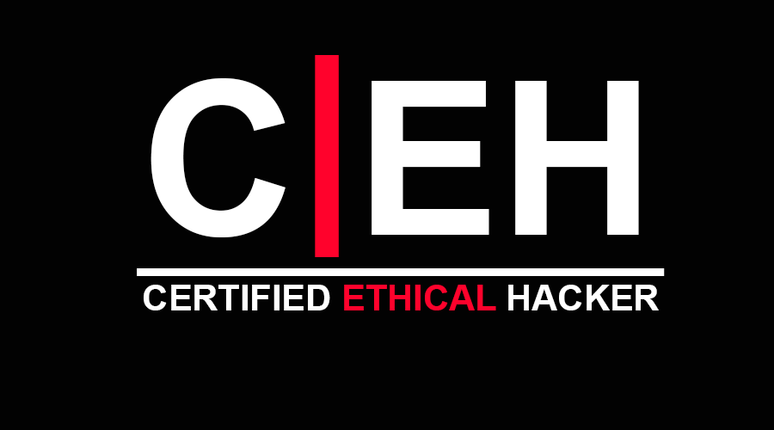
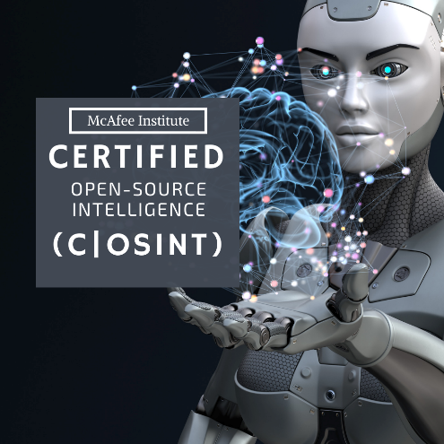
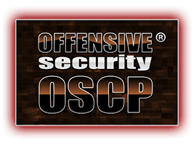


Slide 4
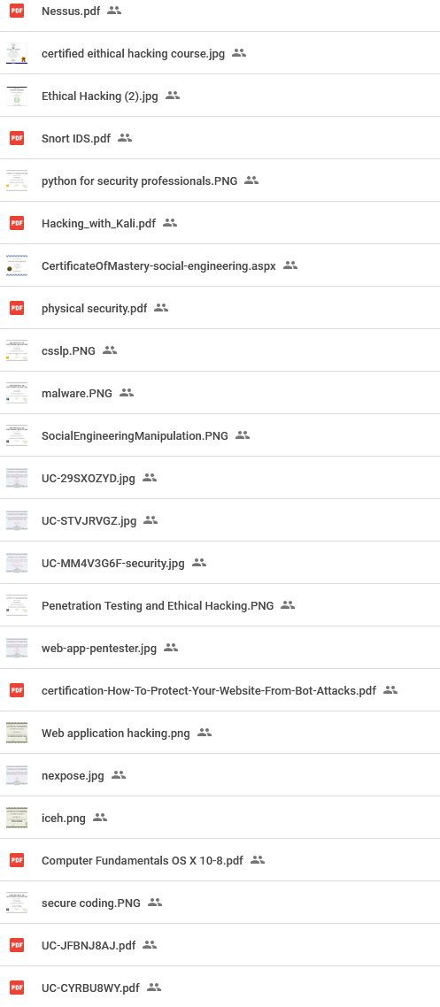
Some of my certifications….
3 Engineering certifications, certified hacker, information security, bla, bla, bla…
Way too many certificates of completions also.

Slide 5

Don’t make my mistake(s)!

Slide 6
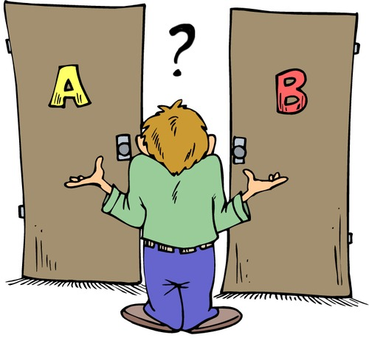
Certify?, Don’t certify?, Certificate of completion?

Slide 7
What is your goal(s)?
Personal growth?
Work requirement?
Make yourself more desirable for employers?
Improve your personal position at work?
Personal growth (CPE work credit)?

Slide 8
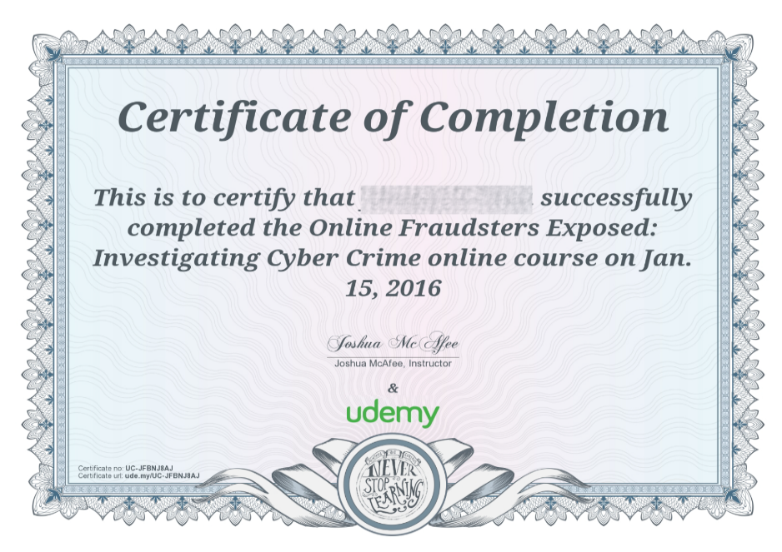
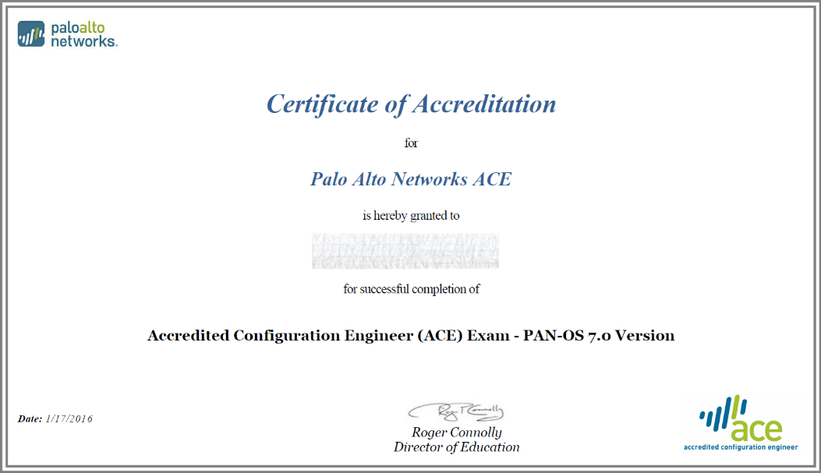
Certification and certificate of completion
Normally does not require a test
Can get CPE credits
May be useful to show employers
Can be a great learning avenue
Not the same as a certification
Normally will require a certification test
Can get CPE credits
Generally awards a title
Generally more sought after by employers
Can be very expensive!

Slide 9

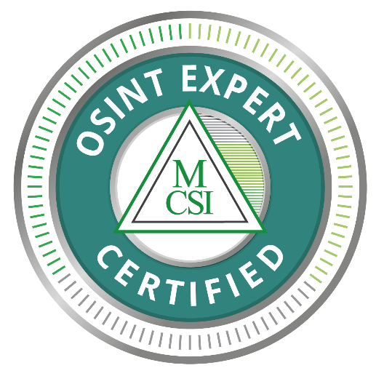
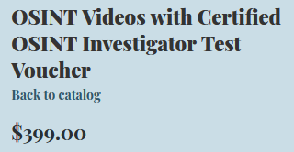
To see what is available
What is affordable
Accessible
Some level of reputation/qualification
Must be a certification
Preferably inclusive (ie. Training/certification)
*I don’t recommend either, if you purchased one or both and are happy,
That is totally fine.

Slide 10
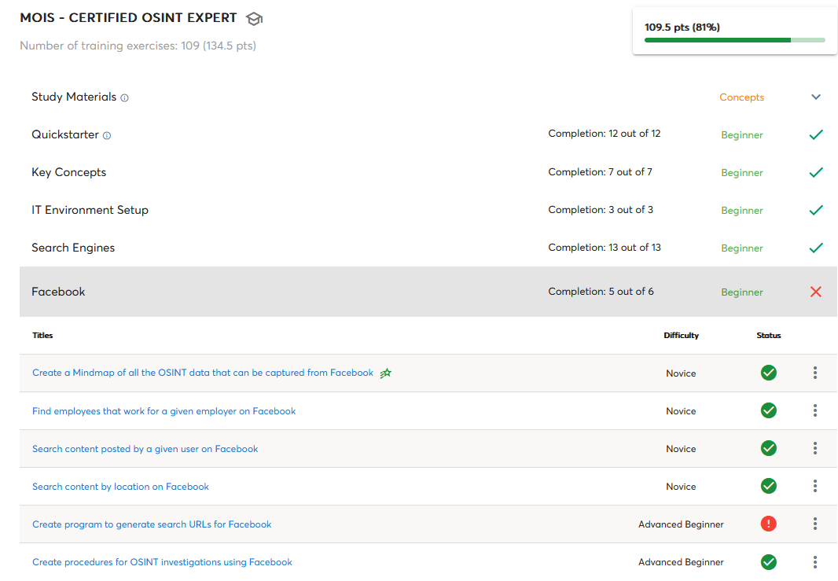
Mosse Institute MOIS Certified OSINT Expert
Reasonably inexpensive ($450)
Practical certification
Some new articles in a positive light
Some reviewers are positive and offer tips
Some outdated or broken tools
Some exercises had confusing goals
Unprofessional response from Mosse
It can take weeks to be graded
Not all sections were created yet
Lack of help (and dead forums)
Stuck in a endless resubmission loop
Broken progress tracking

Slide 11
Hackers Arise
Previously take the CWA though here
Reasonable price
Certification attempt came bundled
Downloadable training videos (good basic content)
No mention of using a VM
No sock puppets or VPN mentioned
Single person running the main operation
Can be difficult to get a hold of anyone
The training videos require you to have a paid DropBox account
The test does not match the training level
Unmasking the target(s) feels wrong
The expectation vs the presented training is disproportionate and
potentially dangerous.
It feels like a setup for failure

Slide 12

So now what?

Slide 13
What to look for
Certifications that are recognized by the organization that you want
Certifications that are all inclusive or affordable bundle
Certifications that are willing to answer your questions before you buy
Endorsed, recommended, vetted, etc.
How often are they updated? Does your content update after you buy?
How long have they been around?
Do they offer practice tests?
How long is the certification good for?
Is it actually a certification or just a certificate?
Is the certification issued a unique ID to verify?

Slide 14
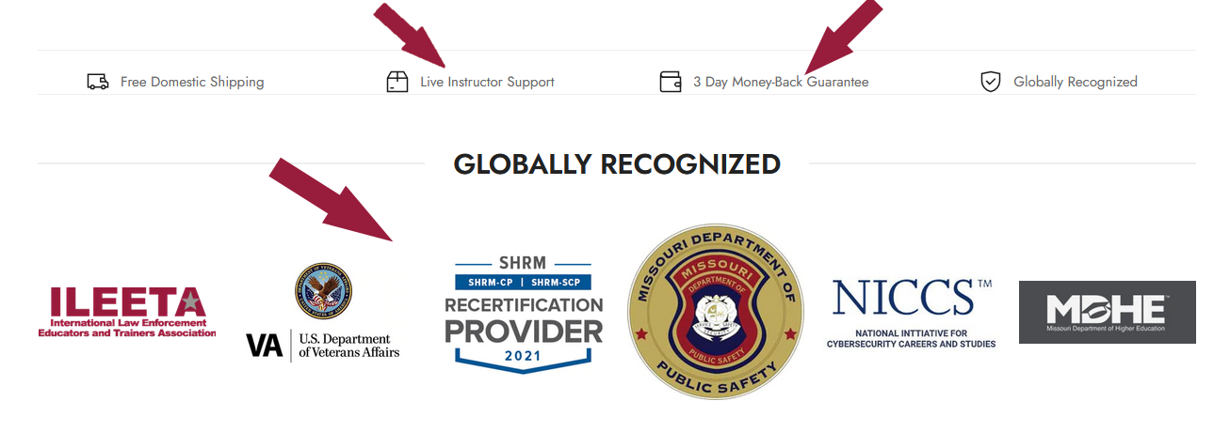

Slide 15
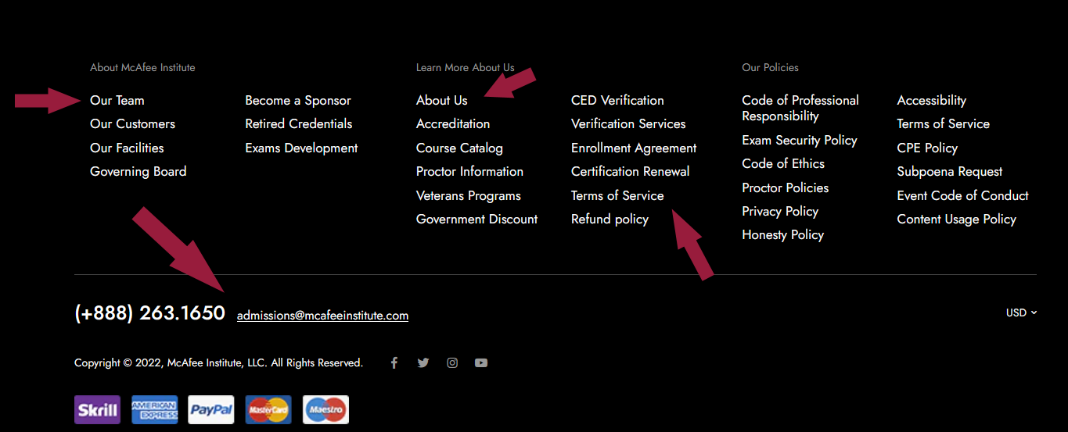

Slide 16
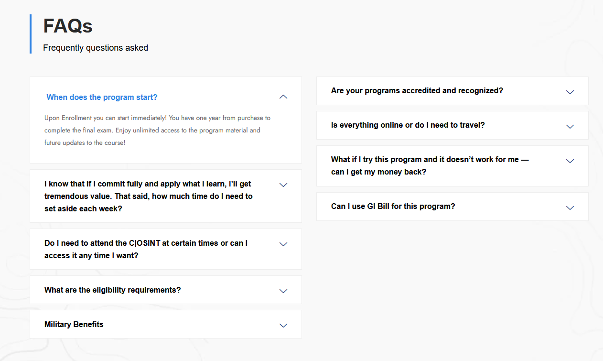

Slide 17


